Slide 1
Topical Steroid Abuse A presentation for Family Physician by IADVL.
IADVL THEME FOR YEAR 2019-
“FIGHT TOPICAL STEROID MISUSE”

Slide 2
Typical Tinea cruris
Also called GAJA KARNA- Elephant’s Ear
Notes:
Tinea cruris de novo ( before applying any cream)

Slide 3
Typical Tinea cruris
Notes:
Tinea cruris de novo ( before applying any cream)

Slide 4
Typical Tinea cruris
Pruritic Annular plaque with scaling – A Ring or An Arc
Notes:
Tinea cruris de novo ( before applying any cream)

Slide 5
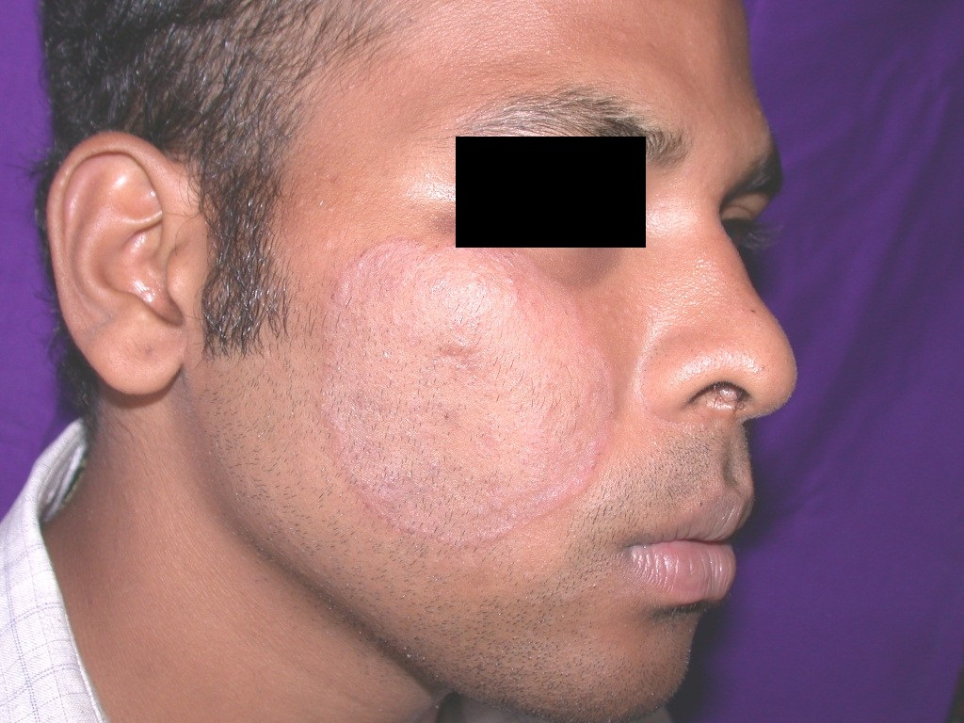
Typical Tinea Faciei
Notes:
Tinea cruris de novo ( before applying any cream)

Slide 6
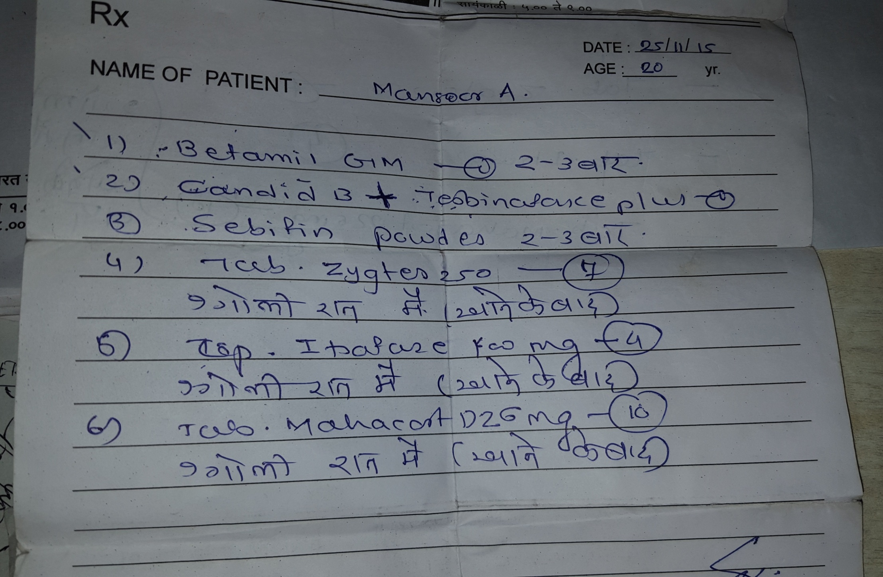
Such type of “ BLANKET” treatment is commonly given

Slide 7
Few commonly prescribed creams
Candid-B Sofradex
Zole-F Tenovate M
Lobate GM Candid Total
Panderm+ Clobet GM
Quadriderm Clodem M
Surfaz SN Cloben G
Betnovate C Fourderm
Betamil GM O2 derm
Dermi 5 Clobikem GM
Cosvate GM Lupiderm GM
Market is flooded with such irrational FDCs

Slide 8
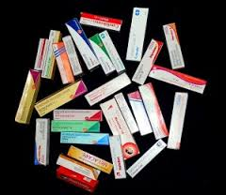
Irrational Fixed dose combination creams are often sold OTC by chemists and also prescribed by GPs
Notes:
Family physician is inclined to give three in one cream (Blanket Treatment) / or chemist gives it

Slide 9
Patient applies it on Ringworm
What happens NEXT ?

Slide 10
Patient applies cream
Relapse
He feels better
He stops applying cream
And the vicious cycle continues…

Slide 11
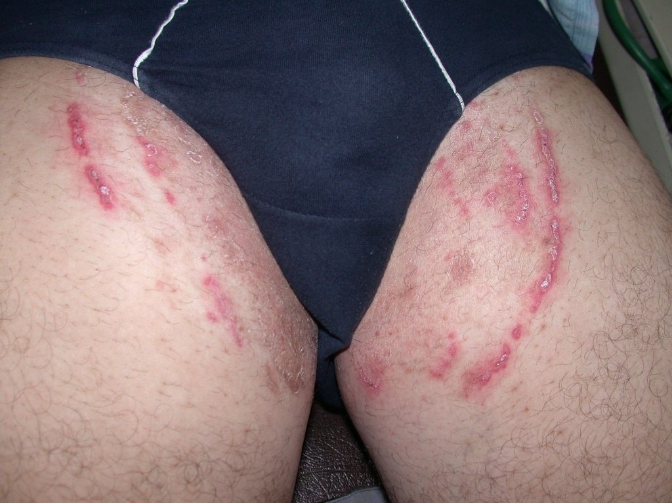
This is Topical Steroid modified Tinea
Multiple rings and arcs, pustular lesions, wide area involved
Notes:
Steroid modified Tinea cruris ( Ringworm –Fungal Infection). Ill defined itchy plaque, broken arcs, activity even in the center.

Slide 12
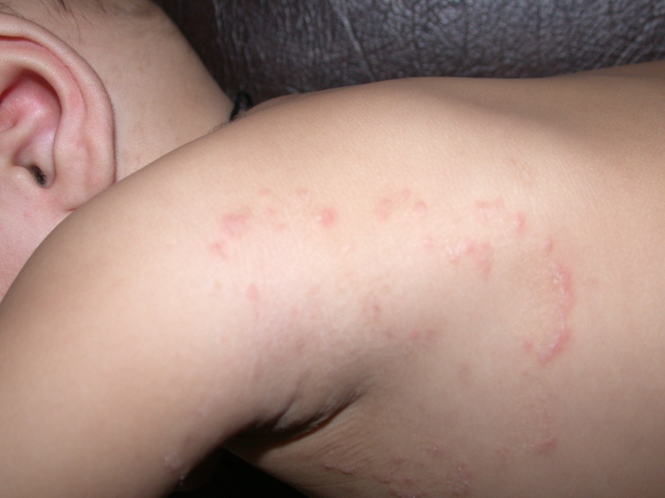
This is Topocal Steroid modified Tinea
Ill defined map, multiple arcs
Notes:
Steroid modified Tinea corporis ( Ring worm-Fungal Infection). Ill defined itchy plaque, broken arcs, activity even in the center.

Slide 13
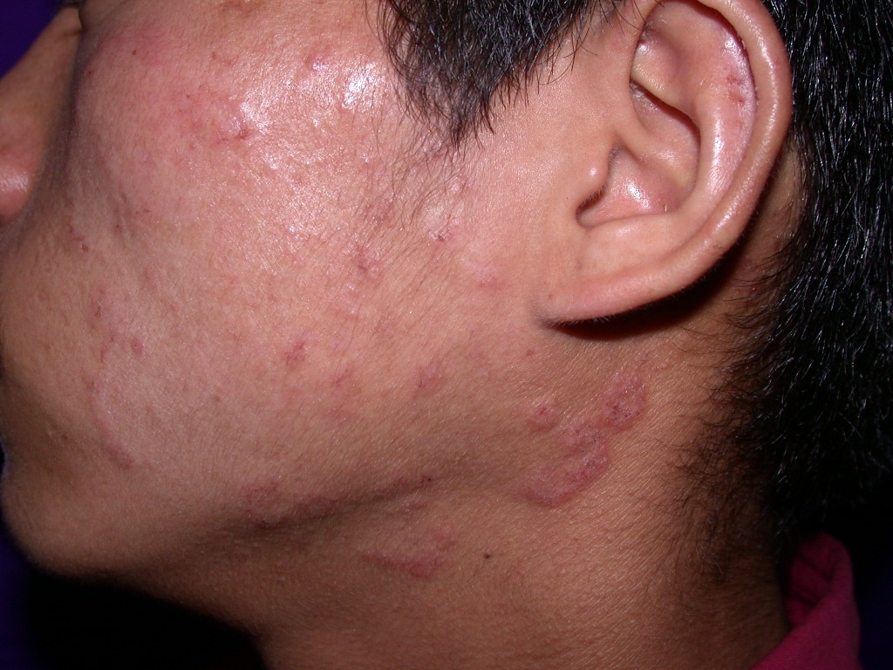
This is Topical Steroid modified Tinea
Ill defined map, multiple arcs
Notes:
Steroid modified Tinea Facii ( Ringworm- Fungal Infection). Ill defined itchy plaque,broken arcs, activity even in the center.

Slide 14
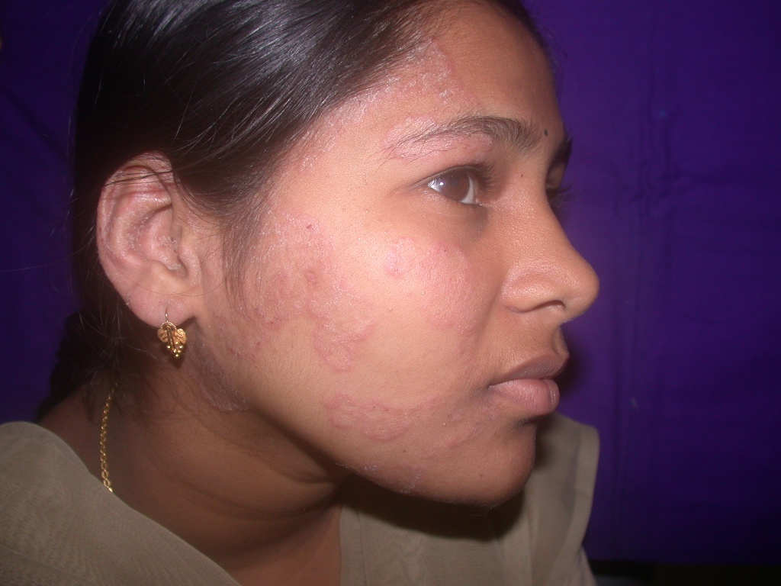
This is Topical Steroid modified Tinea
No
No ring, only multiple arcs, activity even in the center of plaques

Slide 15
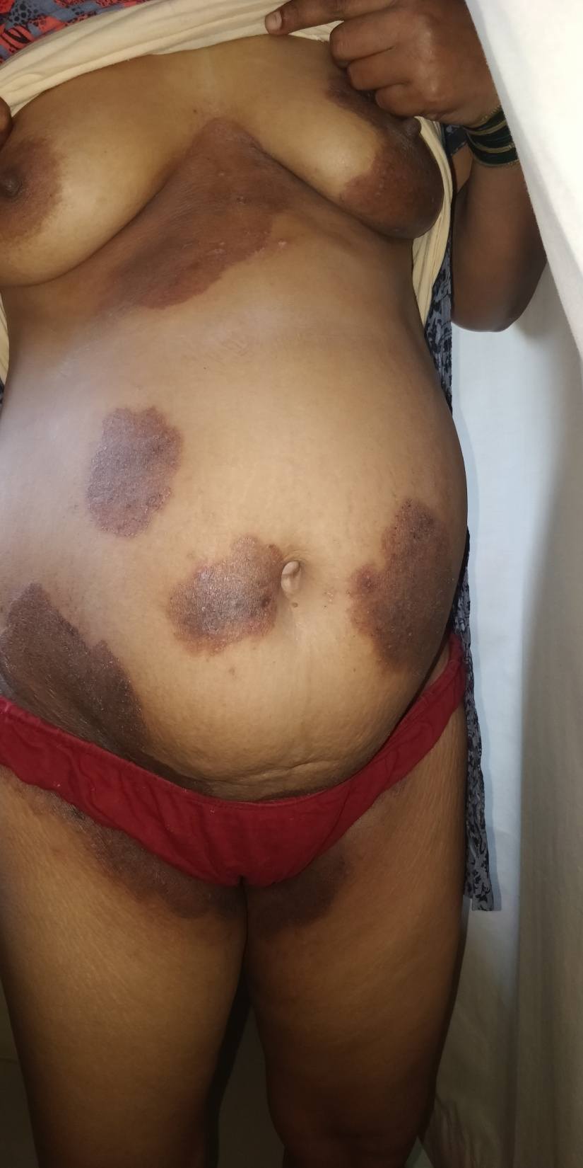
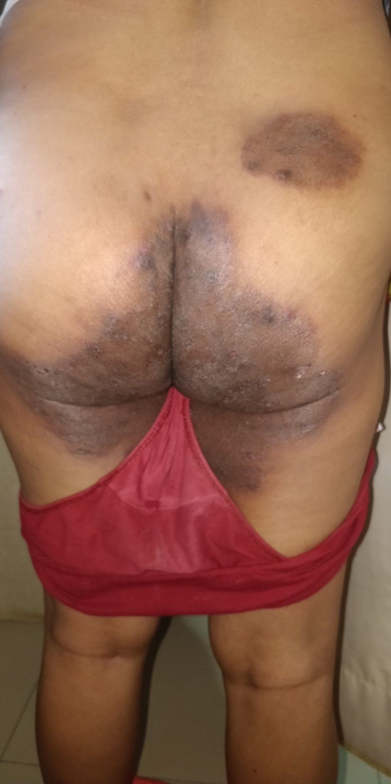
Such extensive tinea is common scinario since last few years

Slide 16
Sincere appeal from IADVL
Do not prescribe steroid containing cream to treat fungal infection.

Slide 17
No steroid cream for Ringworm ( Fungal Infection)
Use plain antifungal cream like
Clotrimazole Eberconazole
Bifonazole Amrolfine
Miconazole Terbinafine
Luliconazole Sertaconazole
Ciclopirox Olamin Ketoconazole

Slide 18
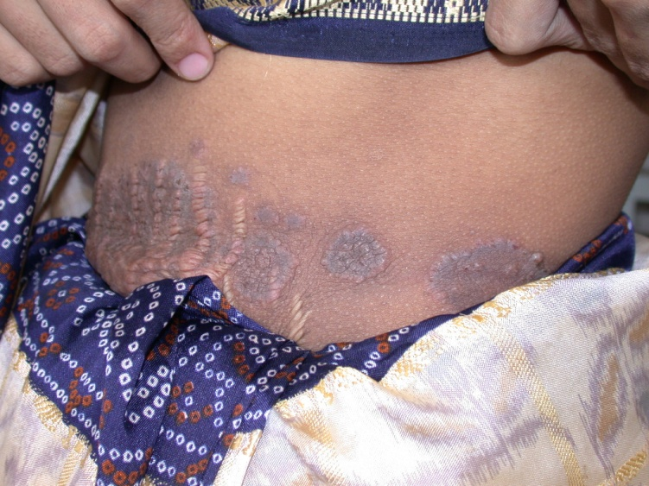
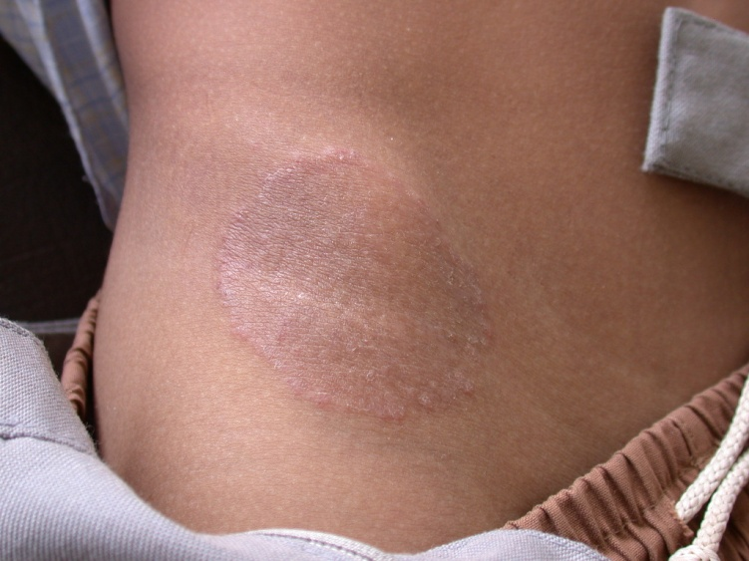
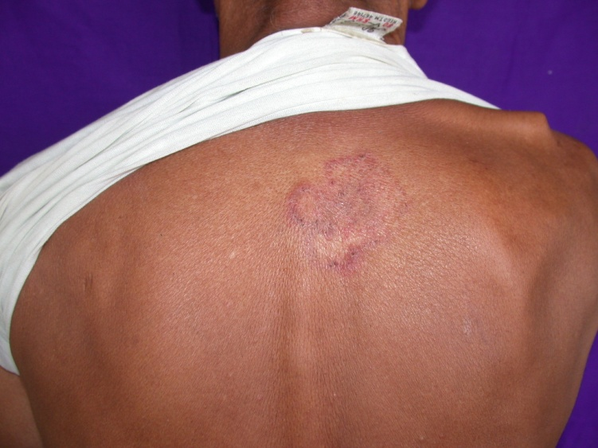
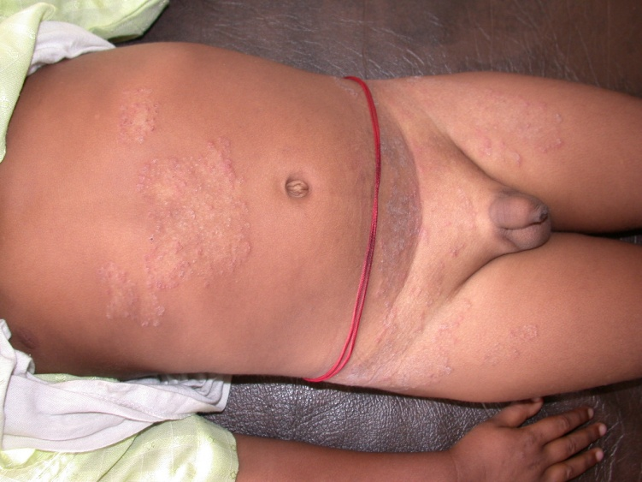
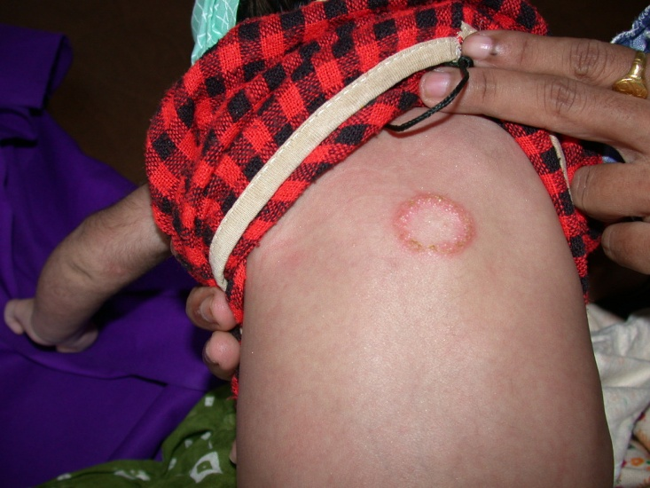
This is how Dermatophyte presents

Slide 19
Steroids
Potent Anti-inflammatory
Anti-proliferative ( Anti-mitotic)
Immunosuppressant

Slide 20
Indications for Topical steroids
Dermatitis- Atopic , seborrhoeic, Nummular eczema, Varicose eczema, allergic contact
Psoriasis, lichen planus
Drug induced allergic rash
Vitiligo
Lichen simplex chronicus
Discoid Lupus erythematosus
Insect bite allergy
It is very useful drug in treating steroid responsive skin diseases.

Slide 21
Side Effects of Topical Steroid
Thinning of skin
Burning of face , face becomes sensitive
Acneiform eruption
Exacerbation of existing acne

Slide 22
Side Effects of Topical Steroid(contd.)
Facial hairs in females
Facial skin becomes erythematous
Telangiectasia on face
Perioral dermatitis, Rosacea

Slide 23
Side Effects of Topical Steroid(contd.)
Striae
Purpura,Ecchymosis
Cushing’s syndrome-Hypertension, Hyperglycemia, Osteoporosis,
Glaucoma

Slide 24
Thinning of Skin
And hence prominent veins

Slide 25
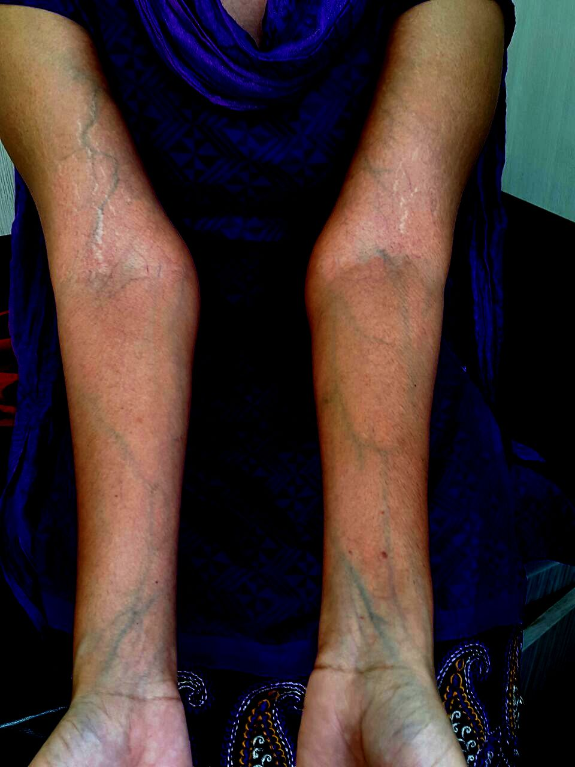
She applied steroid cream on upper extremities to make them fair
No fairness but skin became thin with prominent veins

Slide 26
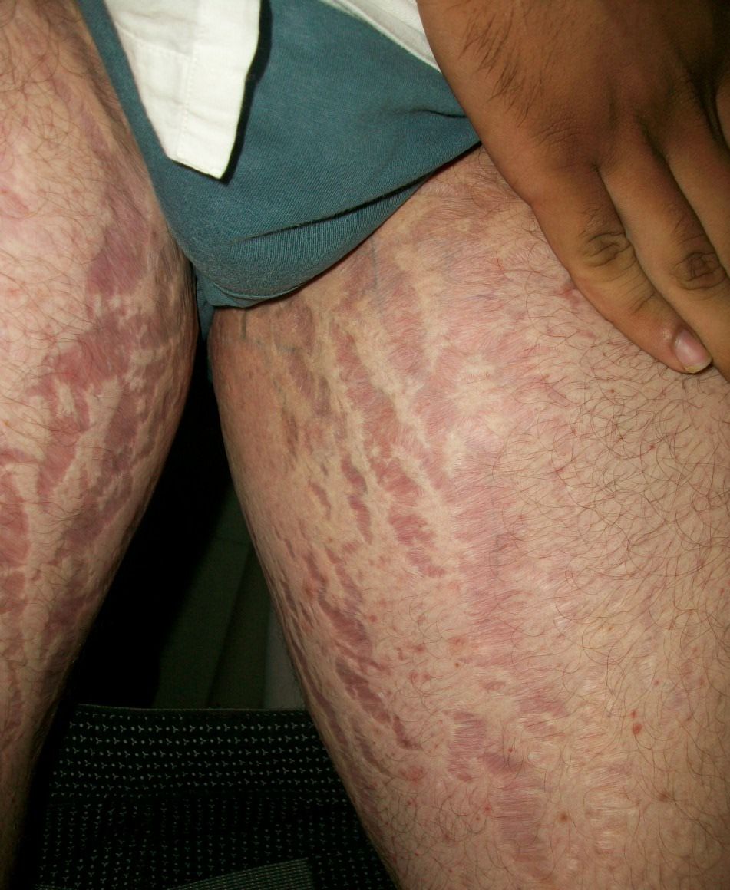
Development of striae (stretch marks)
This is irreversible
side effect

Slide 27
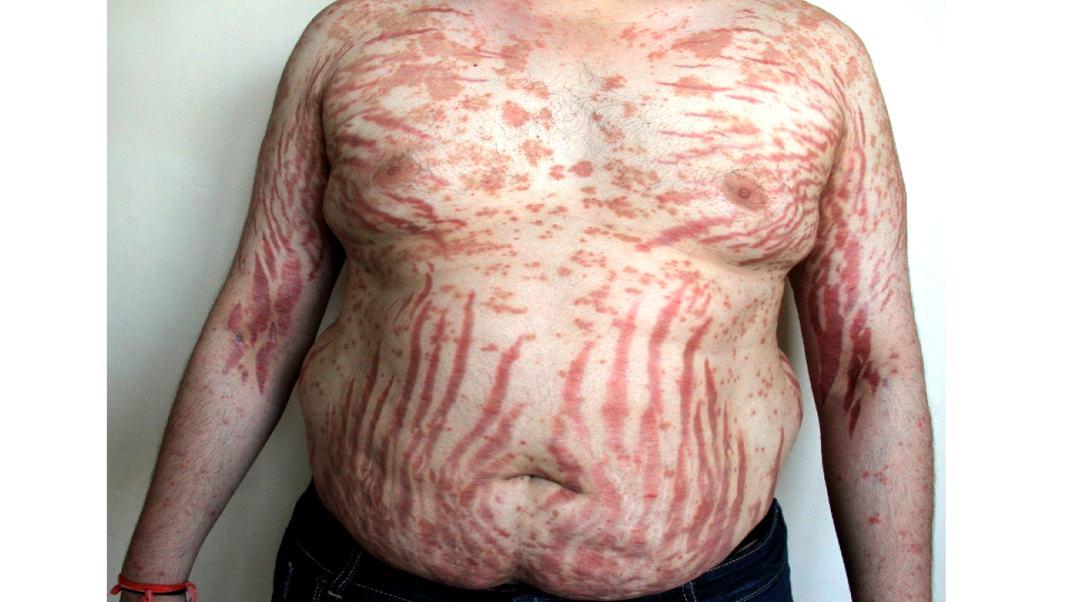
Sever Ugly Striae

Slide 28
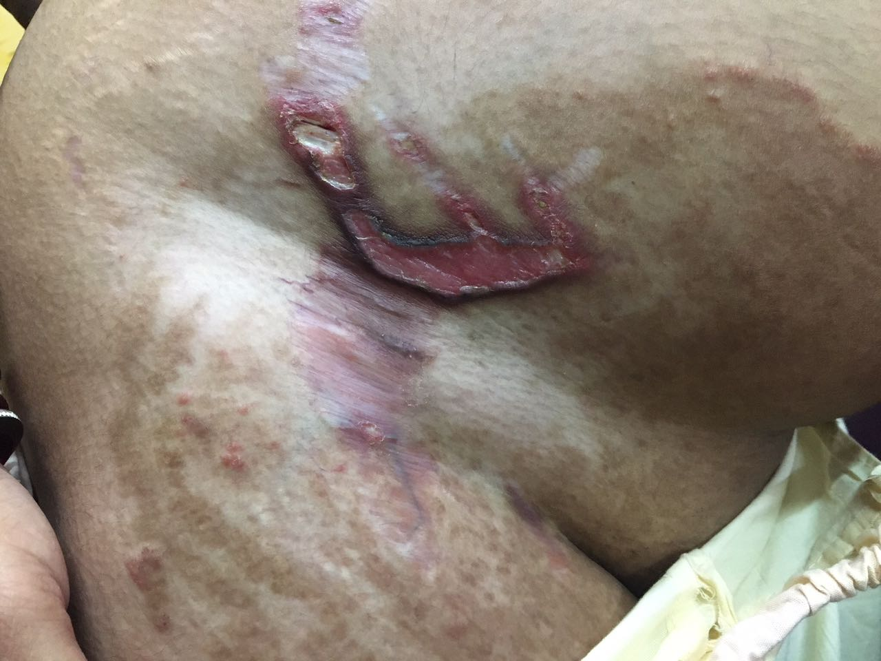
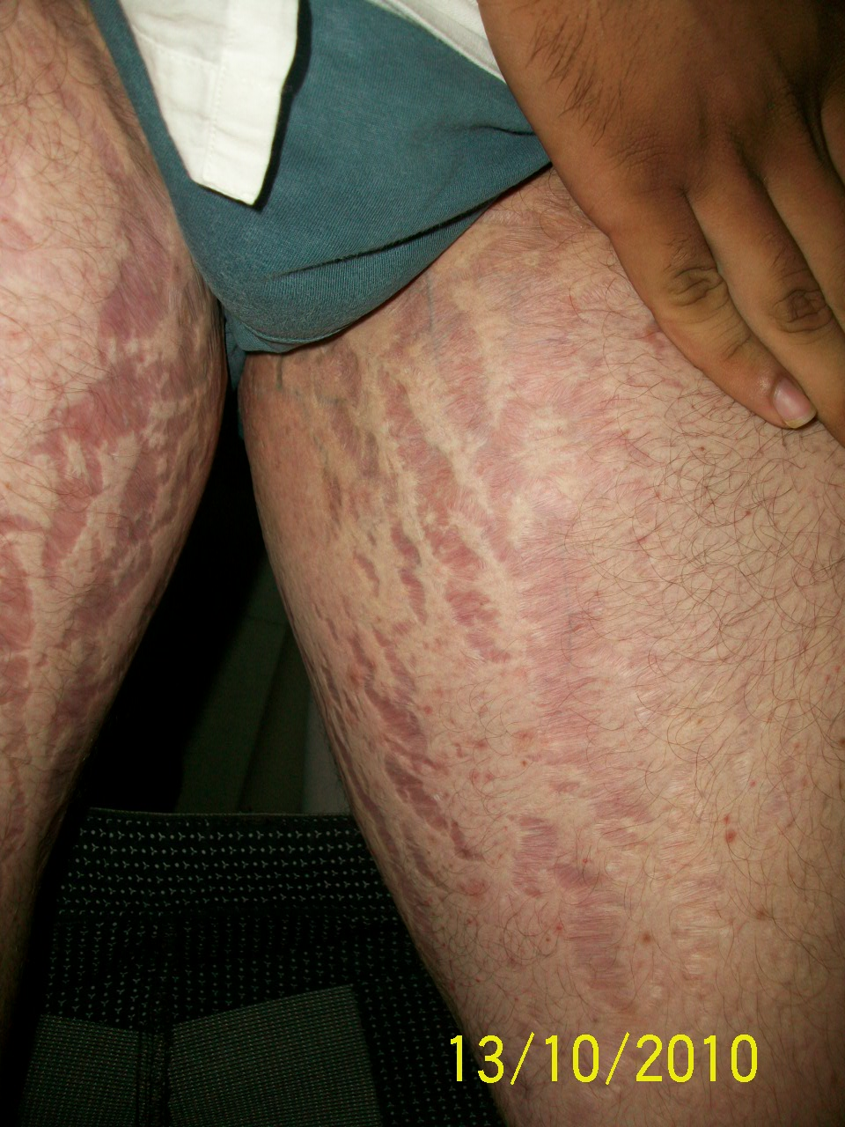
Striae ( Stretch Marks) on Skin
Ulcers develop in stretch marks but fungus prevails.

Slide 29
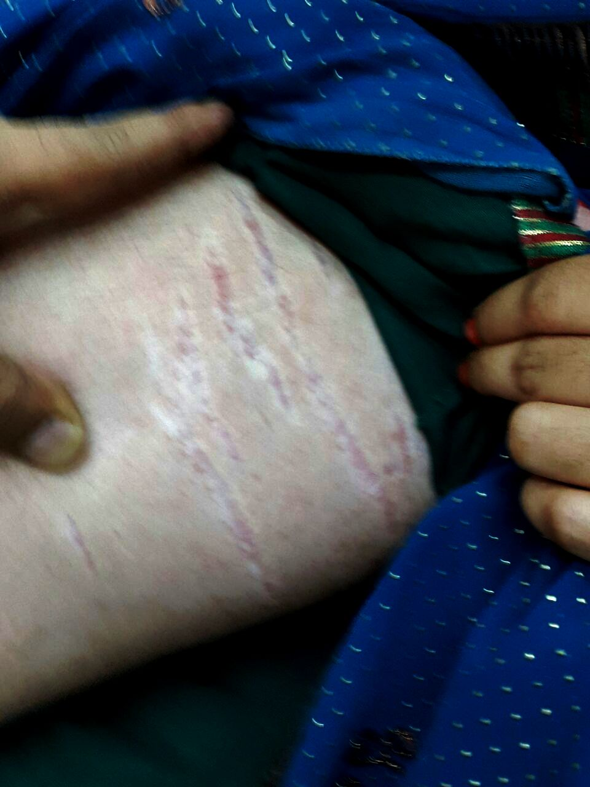
Thinning of skin with stretch marks( striae)

Slide 30
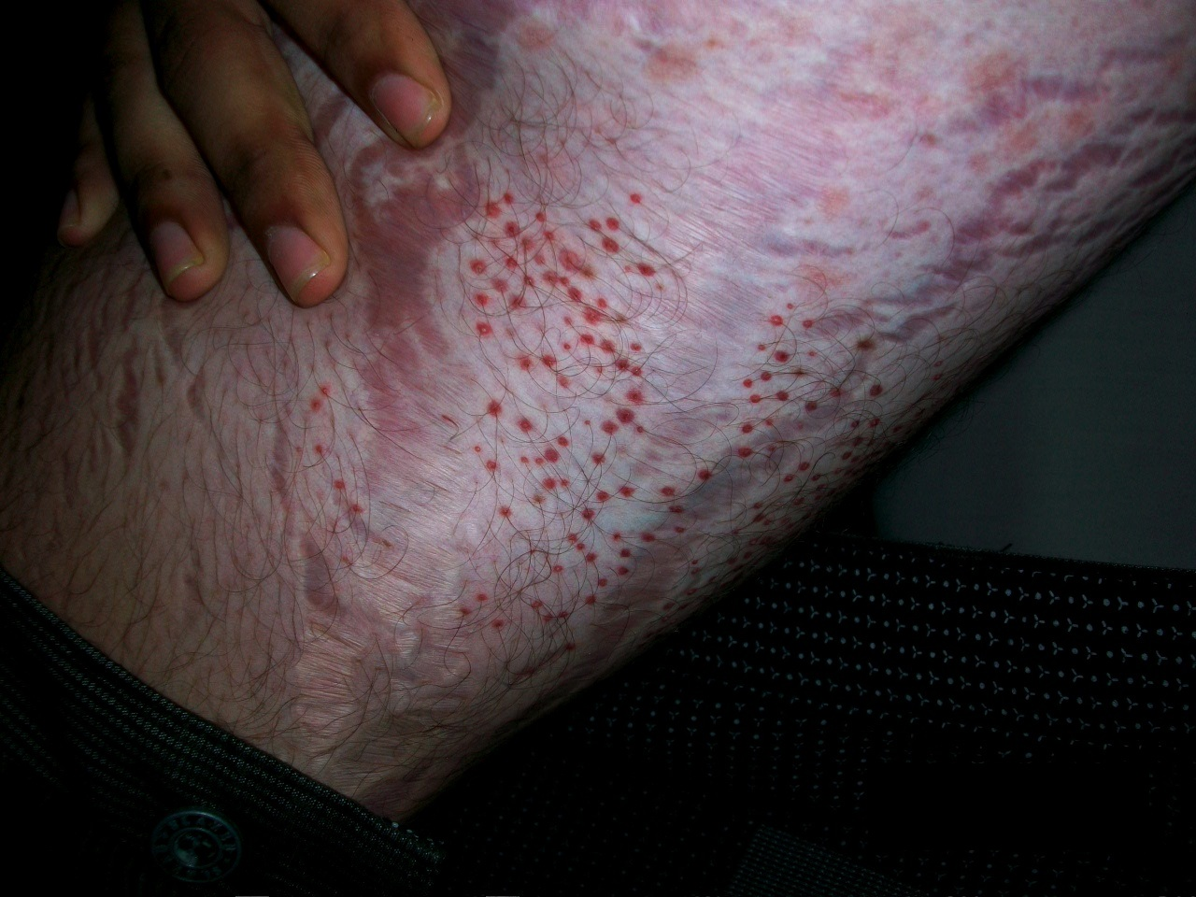
Ecchymosis, Purpura ( along with striae)

Slide 31
Purpura

Slide 32
Skin lightening- Three in One Creams contain
Fluocinolone/ Mometasone
Hydroquinone
Tretinoin

Slide 33
Skinlite, Cosmelite, Melalite XL, Melacare, Melacare forte, Lomela, Getlite, lookbrite, Eveglow, Metacortil lite, Melamet White, Pearl ,Grazia, Metaskin, Liteskin, Melacut, Mosol Plus, Motesol Plus, Acnezac MS, Melanorm MS ,D-Masi, Depig-TM ,M-lite, HQN Plus, Multi HTM, Tinacare, Melabest, No-scar , UB Fair
And many more….

Slide 34
Fairness craze
Young boys and girls, men and women apply such creams on face by recommendation of friends, chemists, relatives or parlor and land up in various side effects on face. This is called Topical Steroid Damaged/ Dependent Face (TSDF)

Slide 35
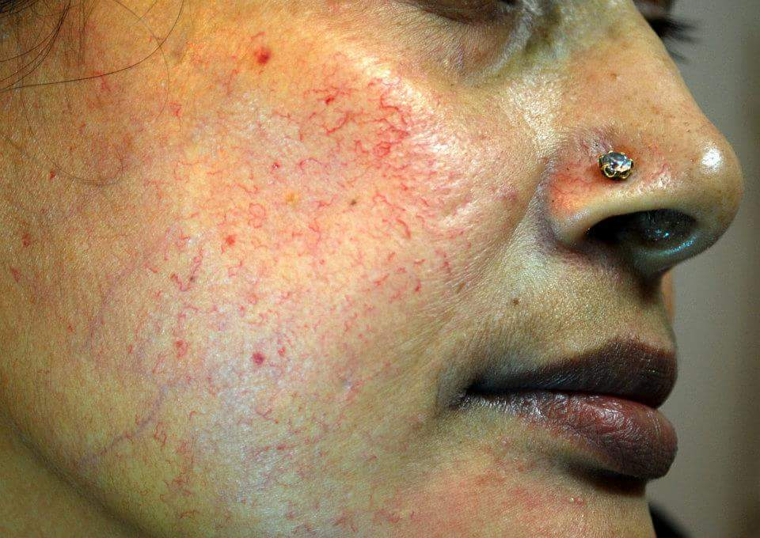
Telangiectasia ( Permanent dilatation of blood vessels)
It is irreversible damage to the skin , responds only to LASERs

Slide 36
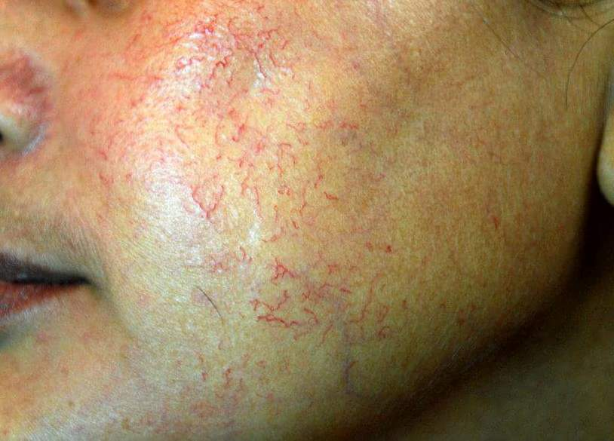
Telangiectasia

Slide 37
Perioral Dermatitis
Erythematous, scaly papules around lips
Erythematous papules around lips

Slide 38
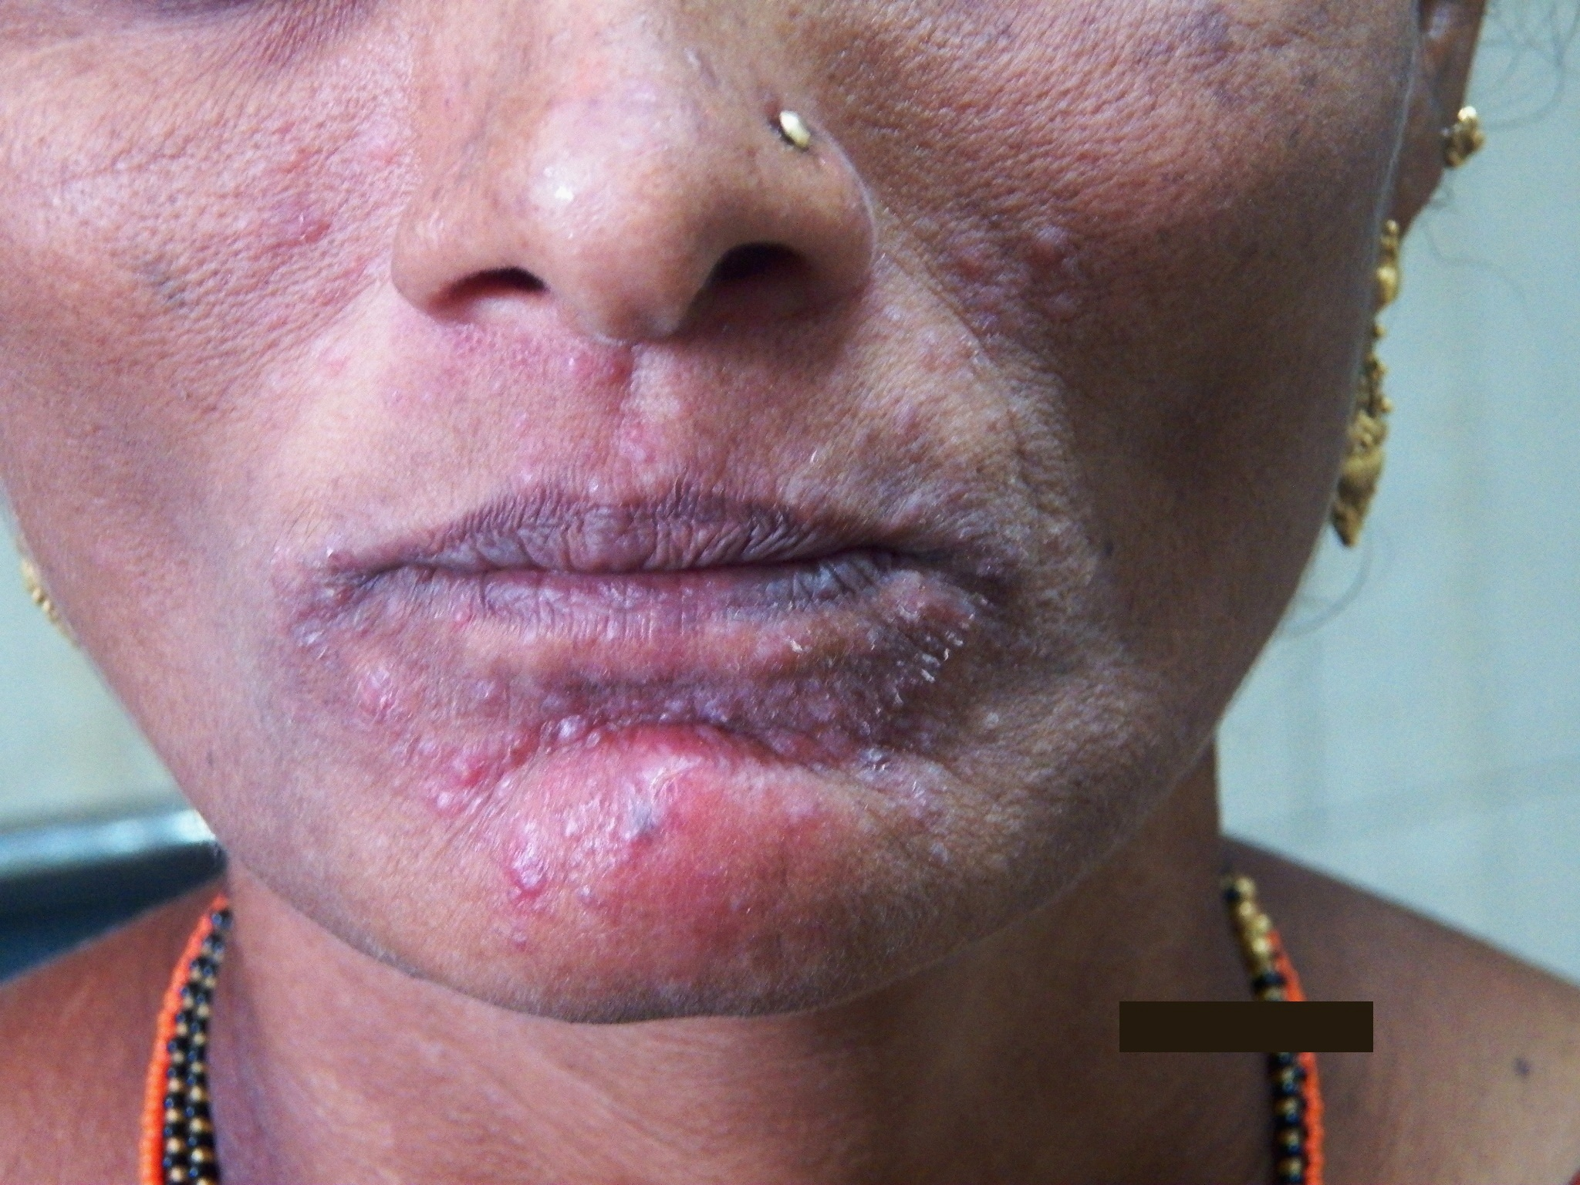
Same patient , close-up view

Slide 39
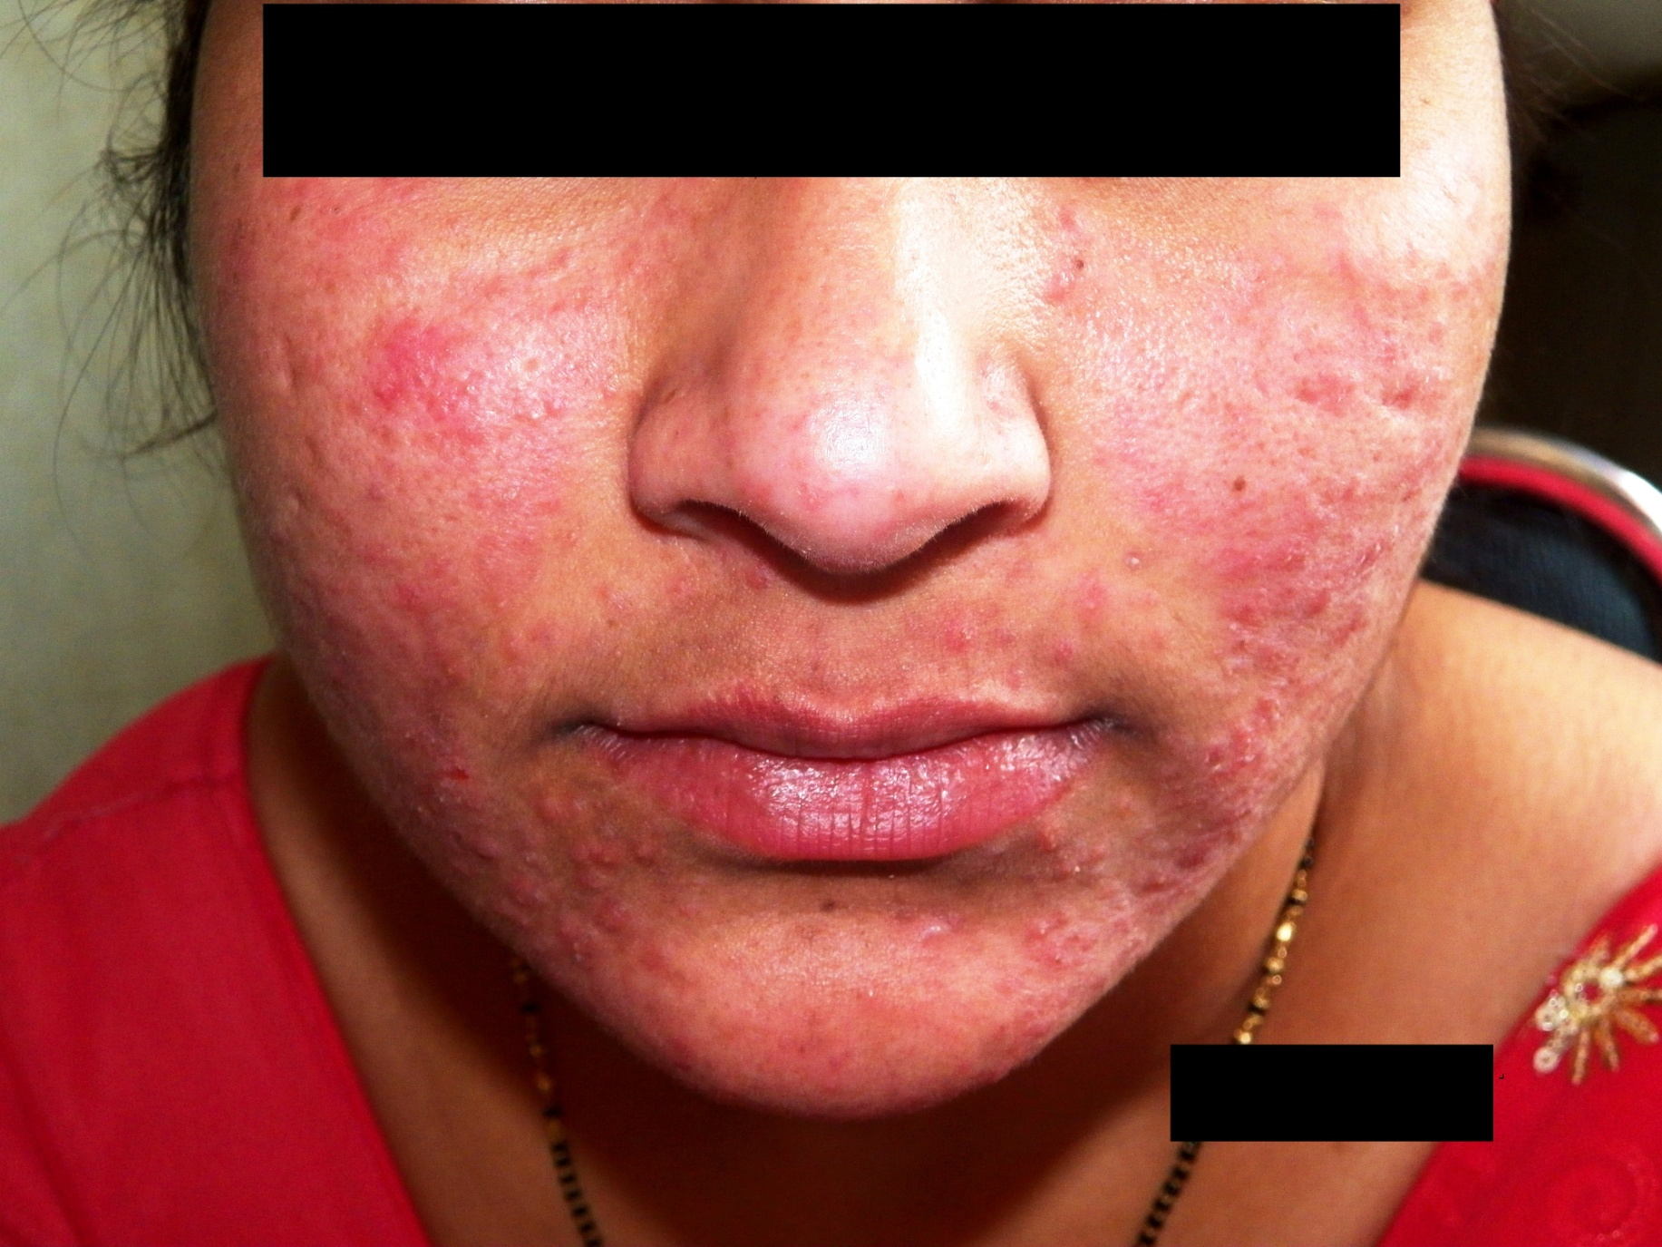
Rosacea

Slide 40
Persistent Erythema

Slide 41
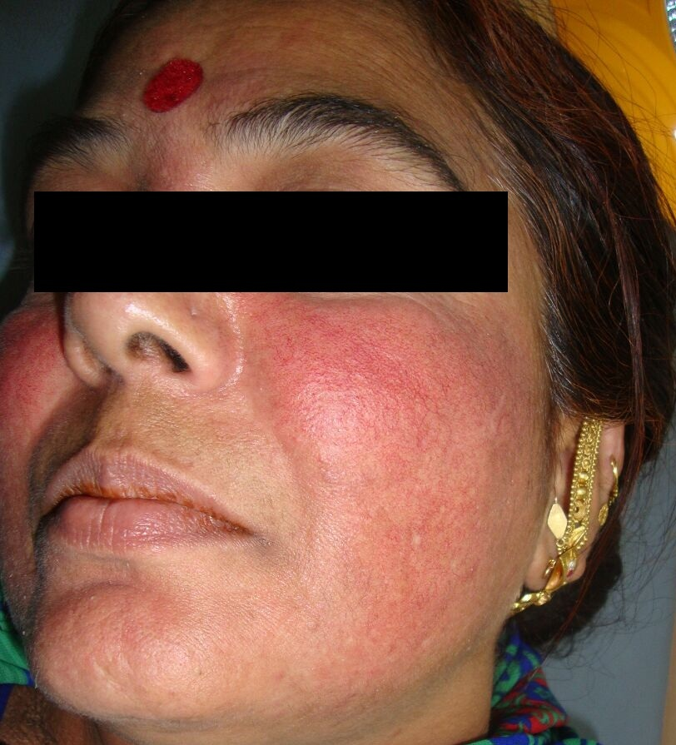
Persistent Erythema
Notes:
Persistent fixed Facial Erythema secondary to application of steroid cream for fairness

Slide 42
Hypertrichosis

Slide 43
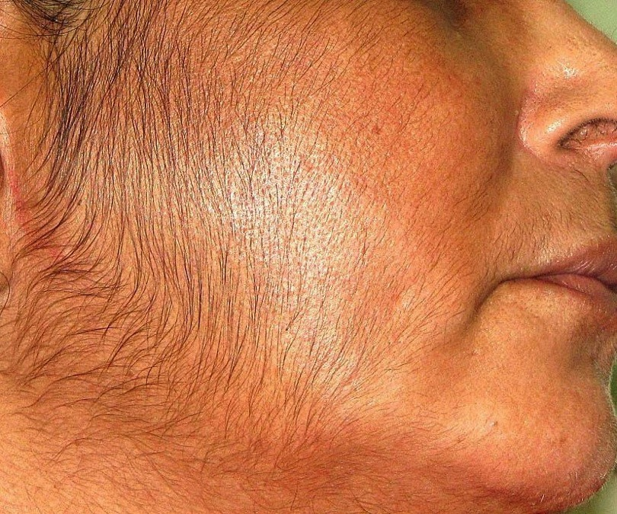
Hypertrichosis
Notes:
Excessive facial hair growth due to application of steroid cream for fairness

Slide 44
Acneiform eruption
Monomorphic inflammatory papules

Slide 45
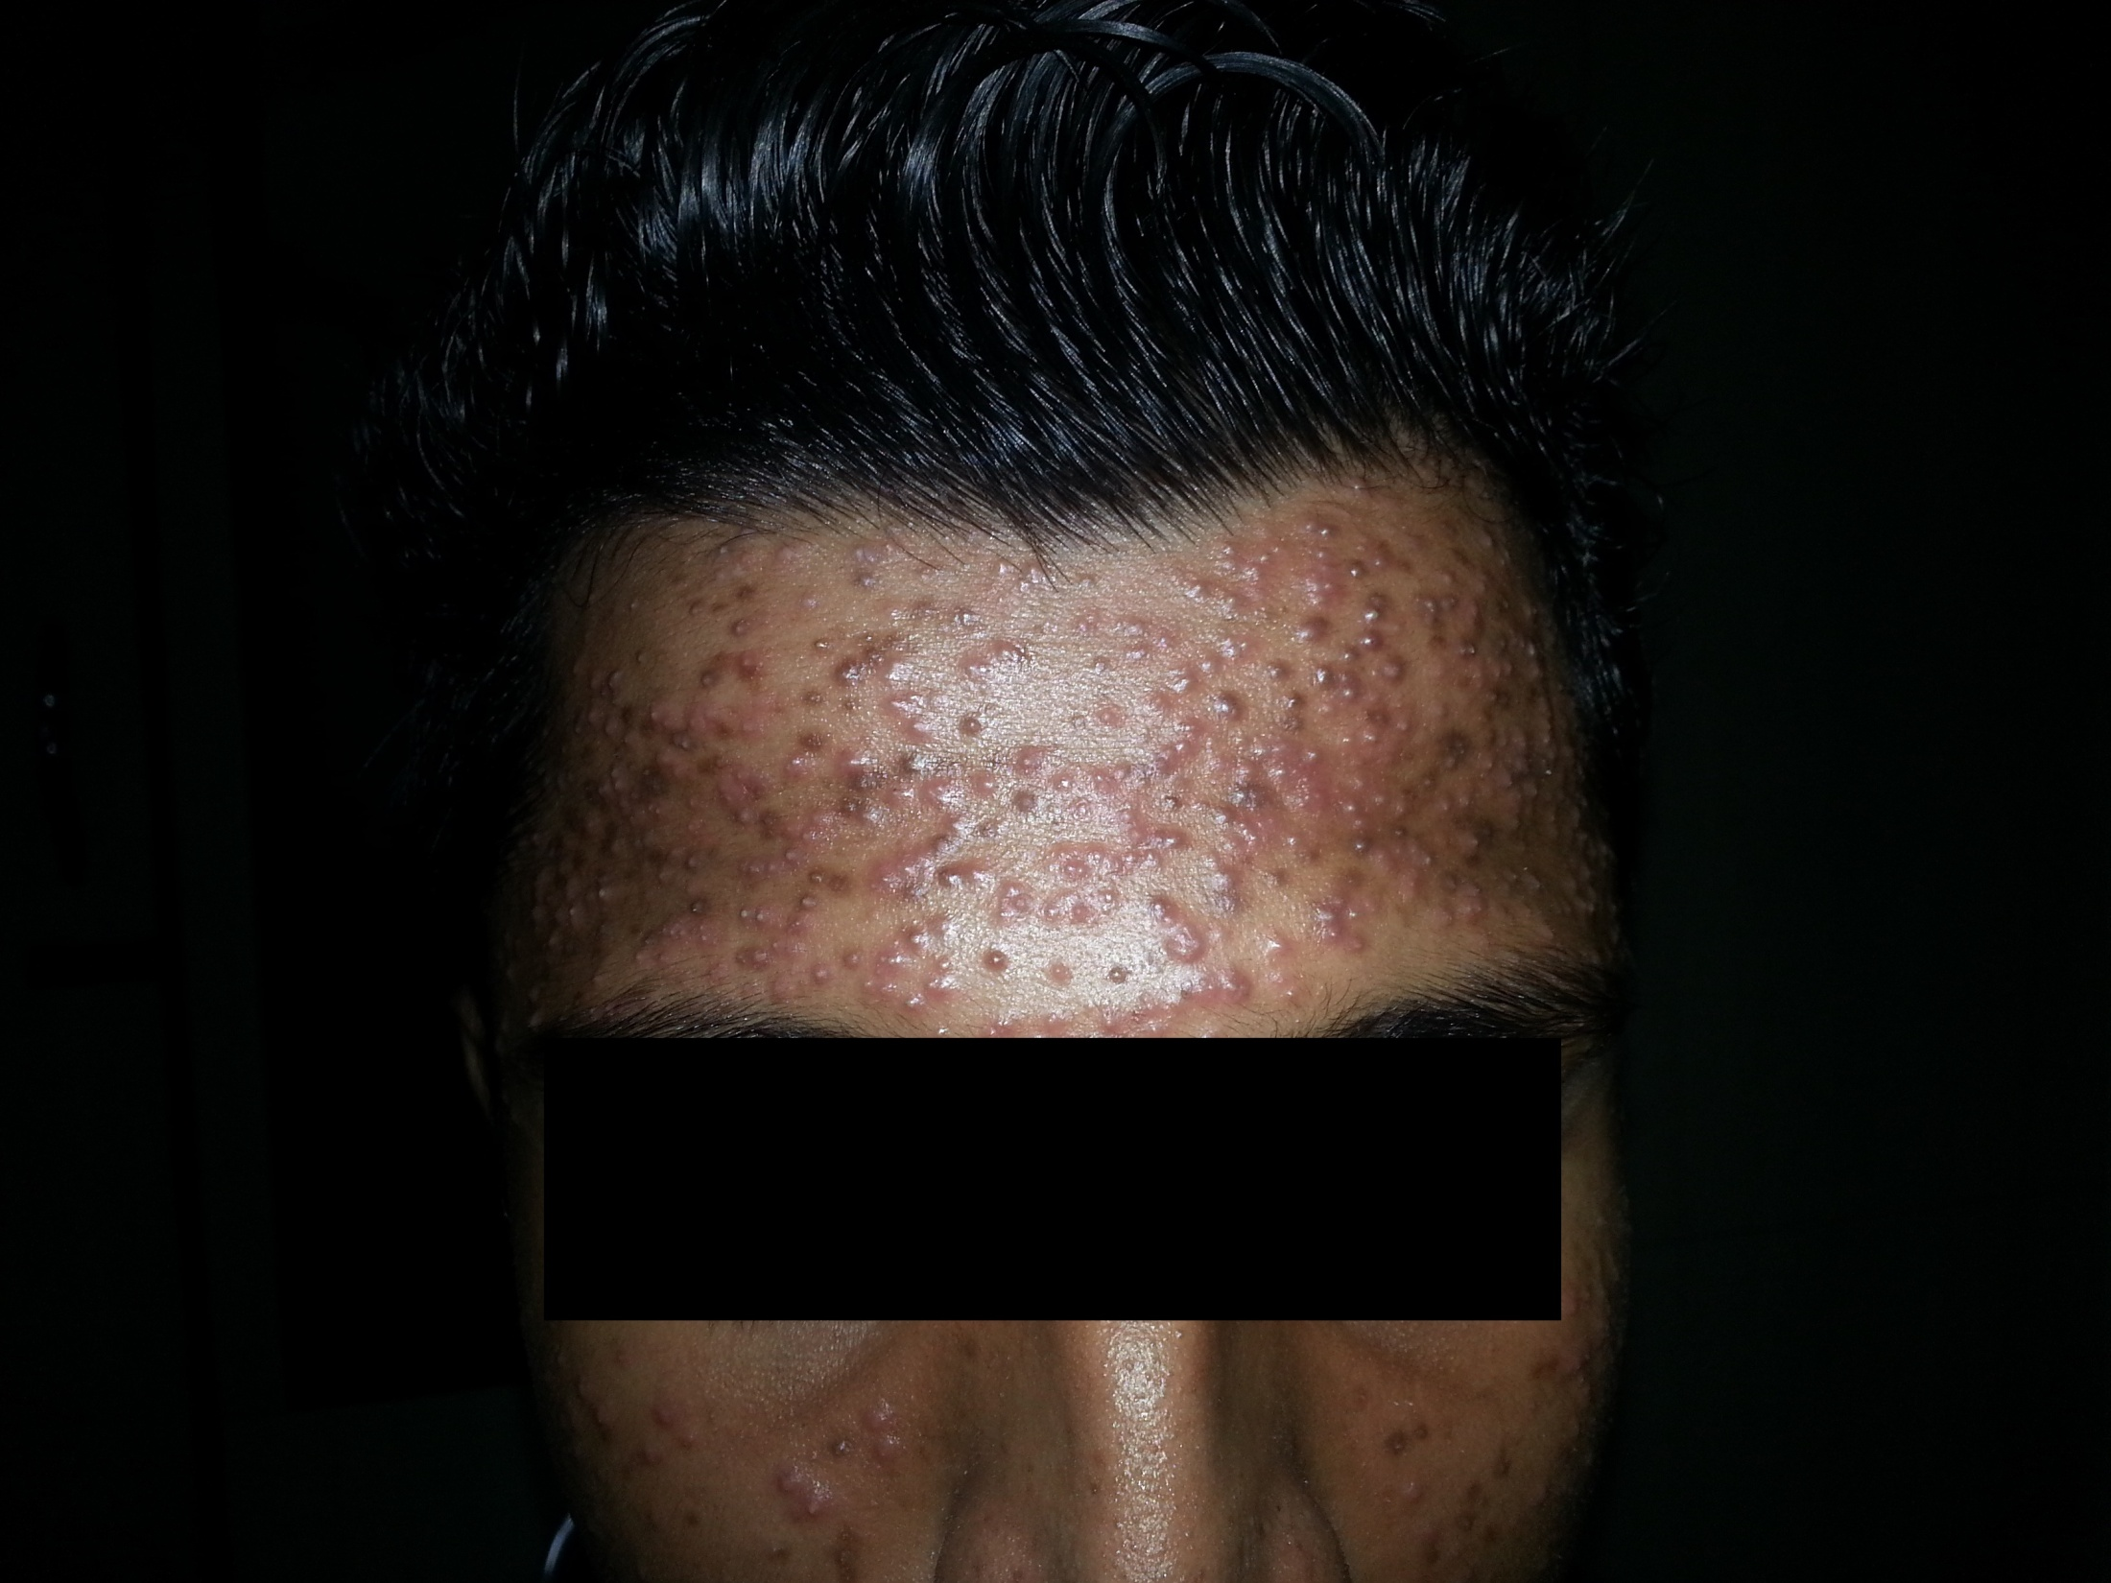
He was given a “Specially made” cream by a parlor for fairness

Slide 46
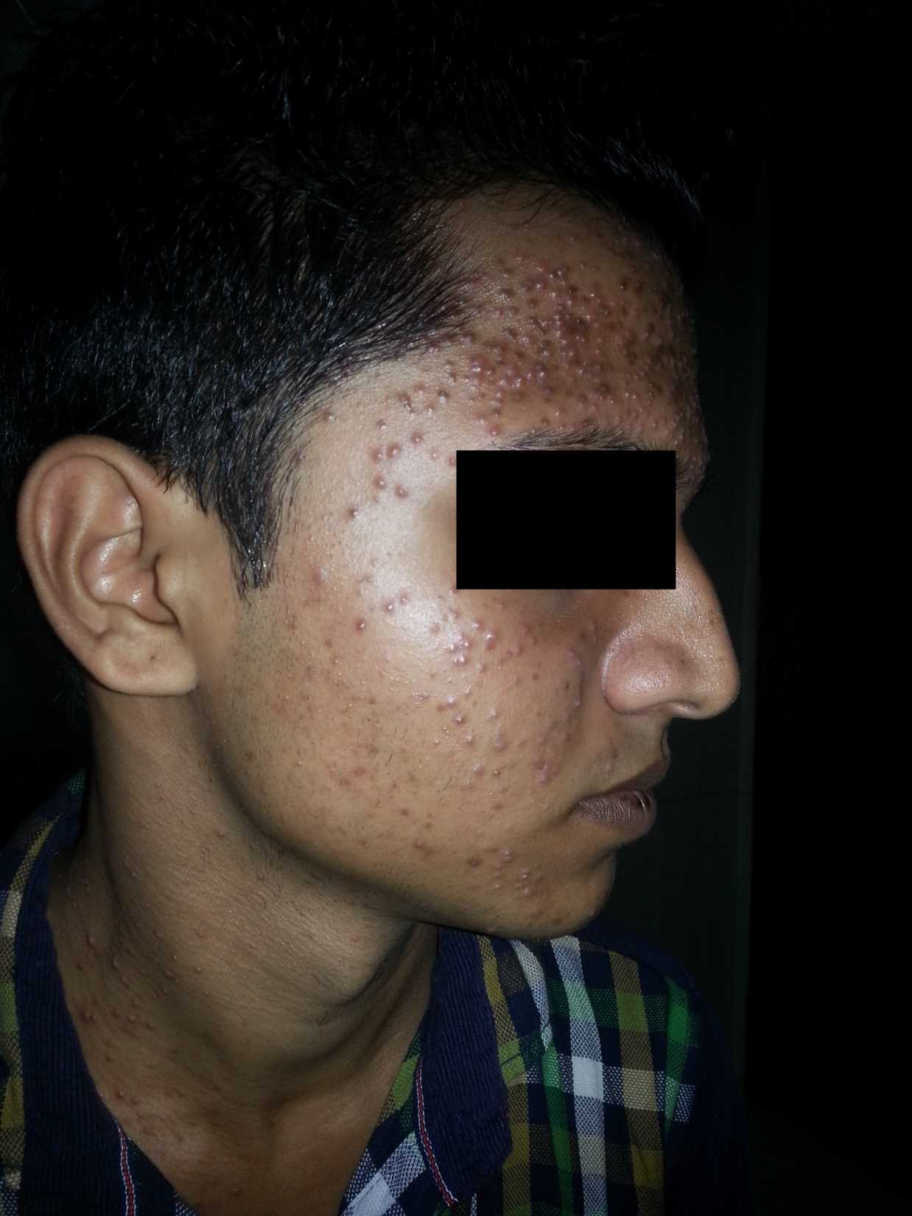
They are not “acne vulgaris”

Slide 47
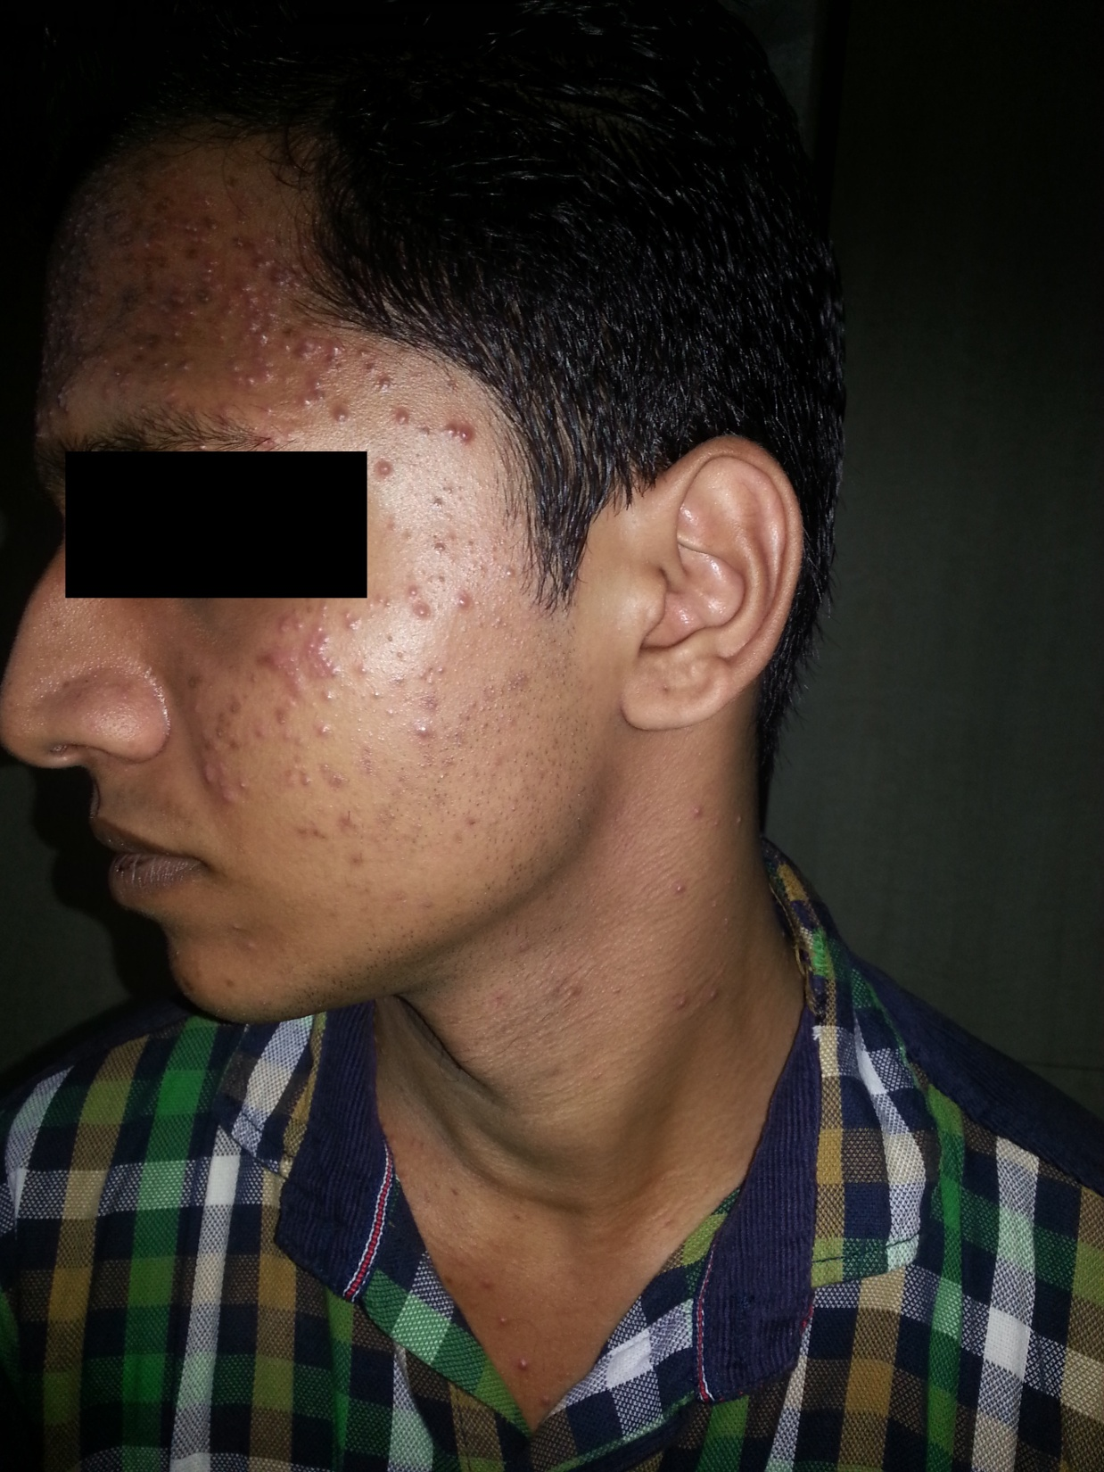

Slide 48
Exacerbation of existing Acne

Slide 49
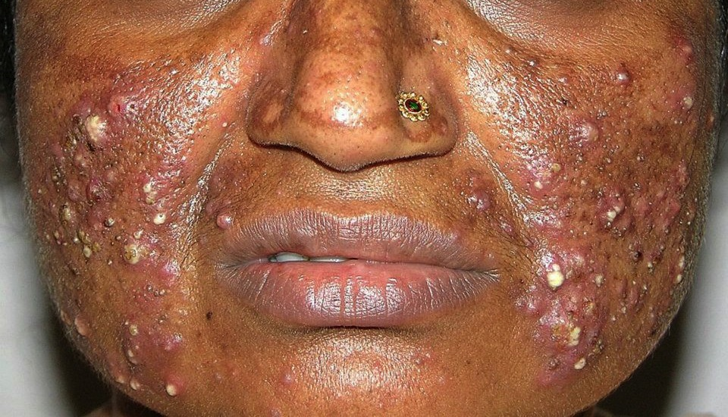
She applied steroid cream for melasma
Melasma was unaffected but severe acne developed
Notes:
Severe nodulocystic acne on face due to topical steroid abuse

Slide 50
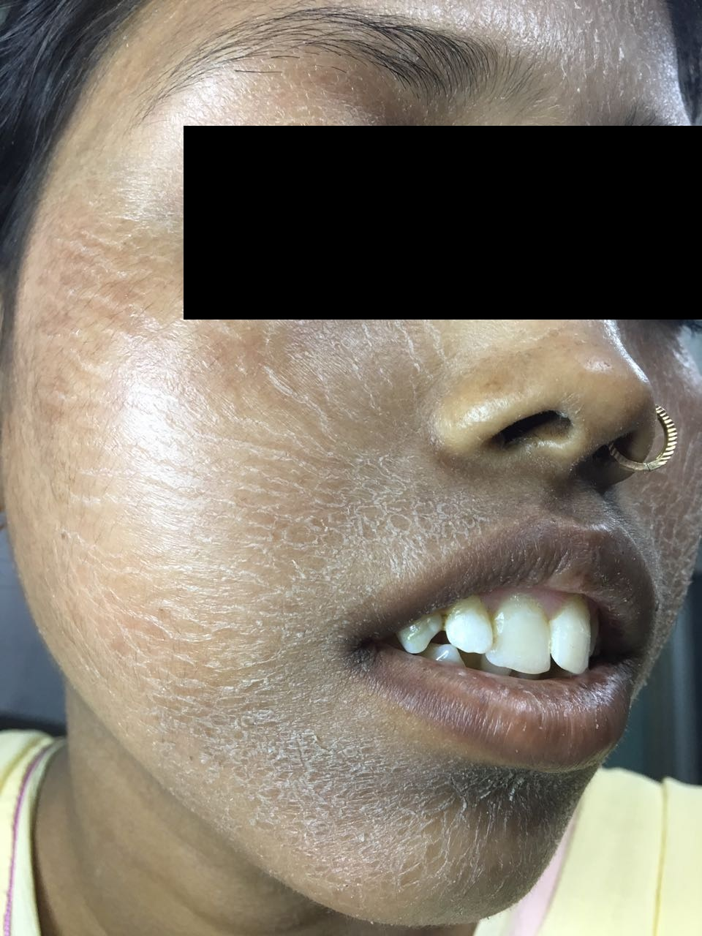
Even very low potency steroid cream can cause side effects
Skin becomes thin, sensitive with burning & stinging.
She had applied Clobetasone butyrate-low potency steroid

Slide 51
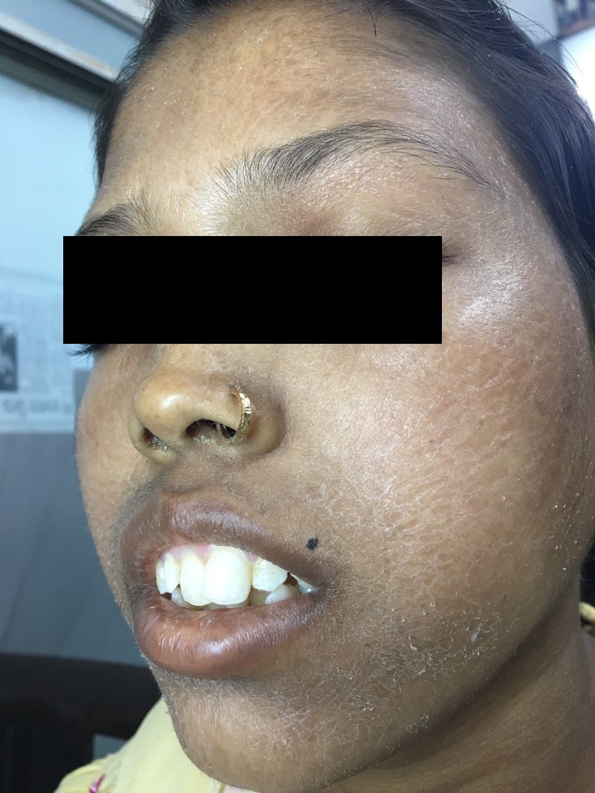

Slide 52
Other side effects of topical steroids

Slide 53
Hypopigmentation
This is side effect of topical steroid. If somebody uses it as fairness cream , he will also get other side effects of steroids. The fairness doesn’t last longer. In fact face becomes more dark.

Slide 54
Masking of Infections
Tinea incognito ( Steroid modified Tinea)

Slide 55
Glaucoma
Steroid ( Clobetasol ) cream was applied around left eye for fungal infection.

Slide 56
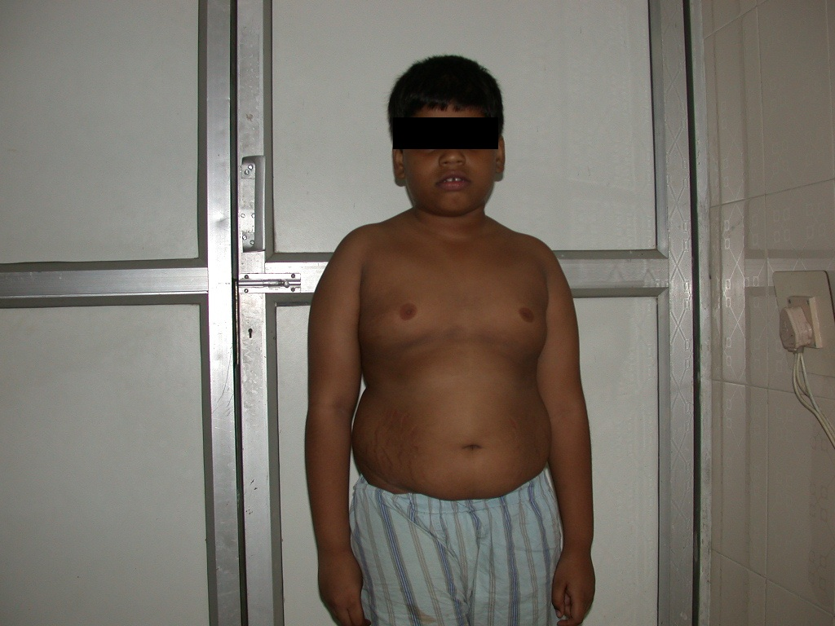
Cushing's syndrome
Clobetasol propionate 1 tube applied per day led to systemic absorption

Slide 57
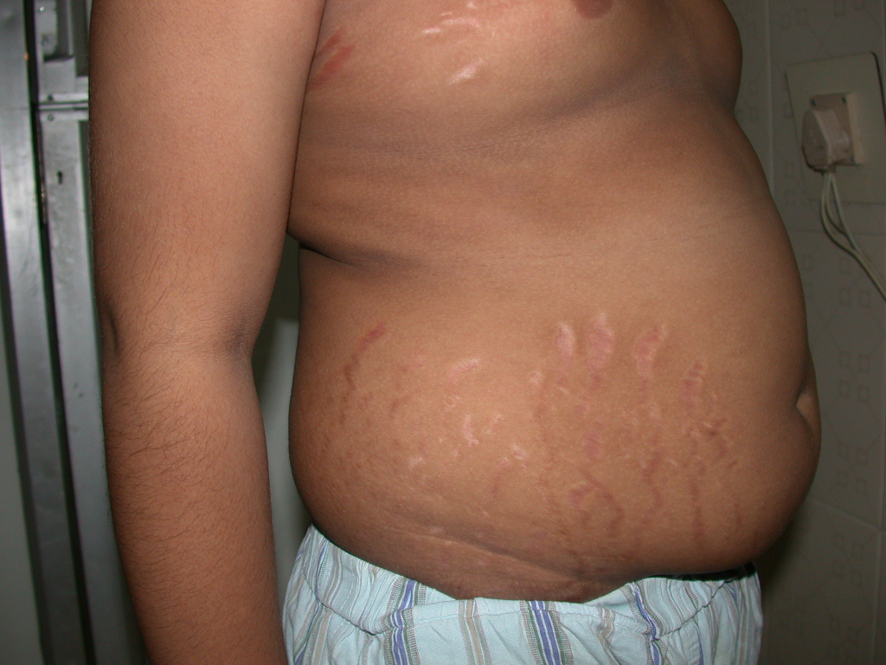
Boy developed obesity, Hypertension and bone resorption
Notes:
Ill defined plaque on left cheek near eye due to clobetasol containing combination cream. Tinea Facii (Ringworm Infection)

Slide 58
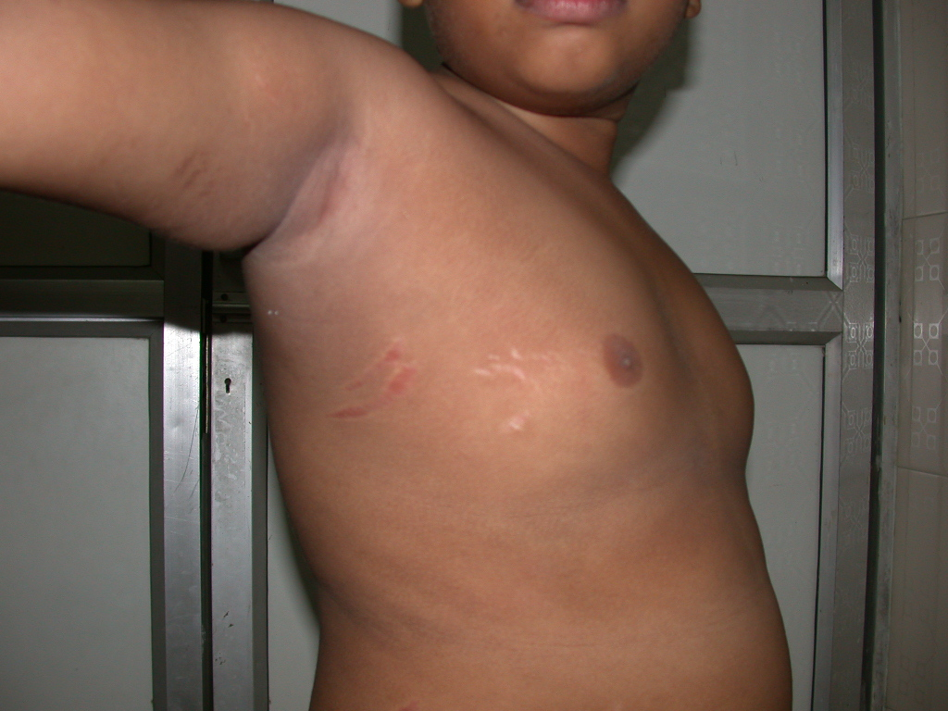
Notes:
Steroid modified Tinea corporis ( Ring worm-Fungal Infection). Ill defined itchy plaque, broken arcs, activity even in the center.

Slide 59
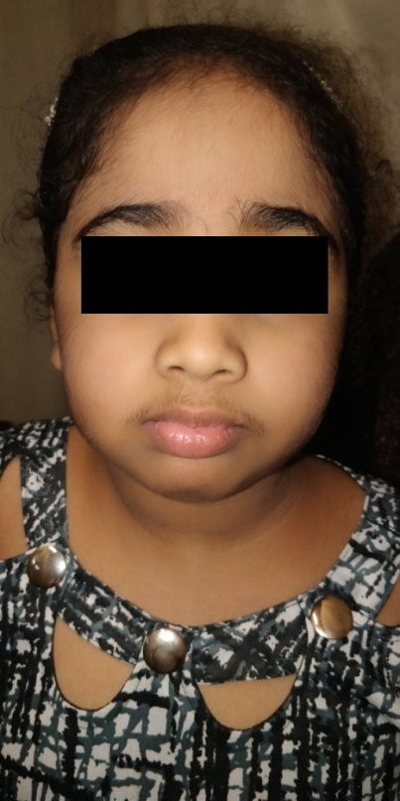
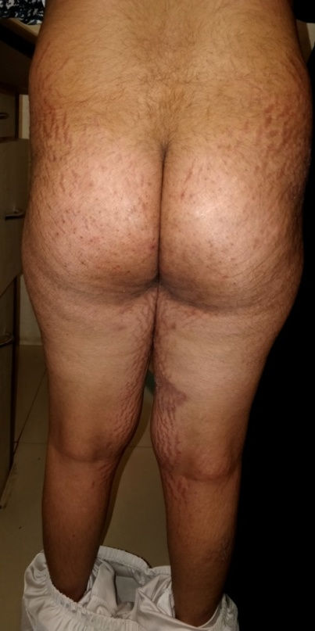
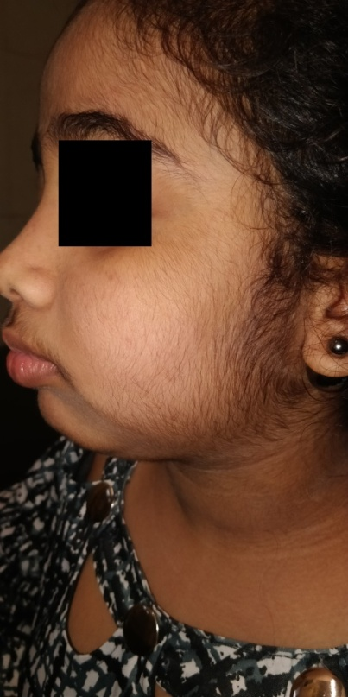
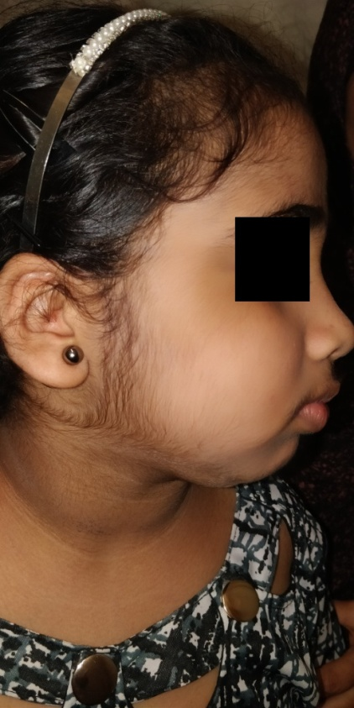
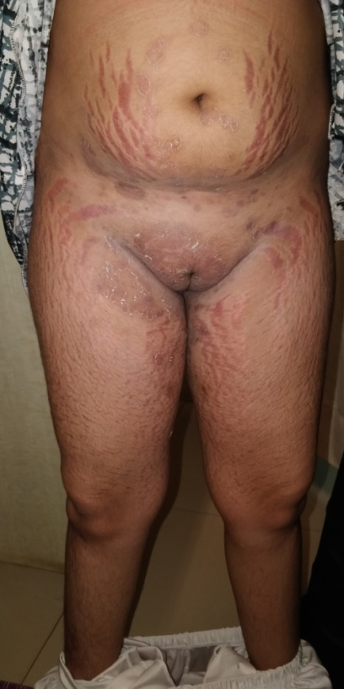
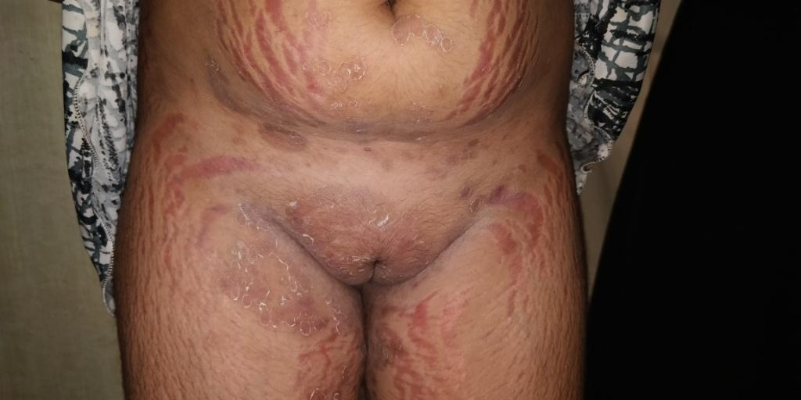
10 yr old girl; developed cushingoid features with obesity, striae and hypertichosis. Used Clobetasol FDC for tinea for 6 months.

Slide 60
Systemic side effects of topical steroids
Cushing’s Syndrome
Hypertension
Hyperglysemia
DUB
Bone resorption

Slide 61
Classification of topical steroid according to potency

Slide 62
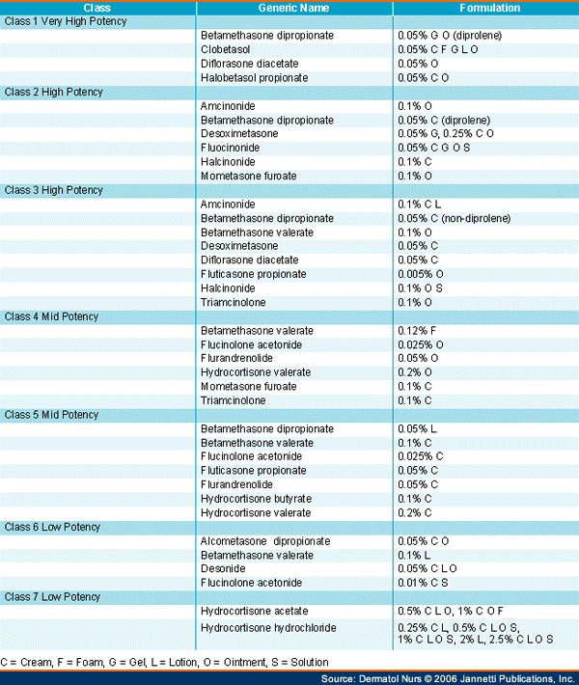
Notes:
7 Classes of Topical Steroids according to Potencies

Slide 63
Avoid Potent Steroids on
Infant
Eyelids
Axillae
Groins
Extensive body surface area

Slide 64
No steroid cream for Ringworm ( Fungal Infection)
Use plain antifungal cream like
Clotrimazole Eberconazole
Bifonazole Amrolfine
Miconazole Terbinafine
Luliconazole Sertaconazole

Slide 65
This is how Dermatophyte presents Pruruti annular lesions with tiny papules, vesicles and scales at the border, also called ringworm or tinea

Slide 66
Kindly do not use fixed dose combination cream for any skin disease. It may ruin patient’s skin.

Slide 67
ITATSA
Iadvl’s Taskforce Against Topical Steroid Abuse
It is for awareness of the issue of topical steroid abuse amongst chemists, doctors and public.
Notes:
ITATSA is initiative of IADVL against topical steroid abuse

Slide 68
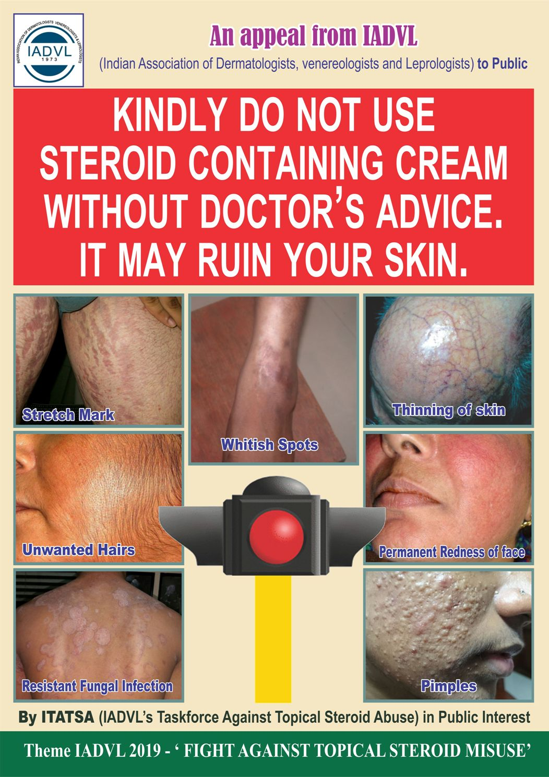
Poster by IADVL

Slide 70
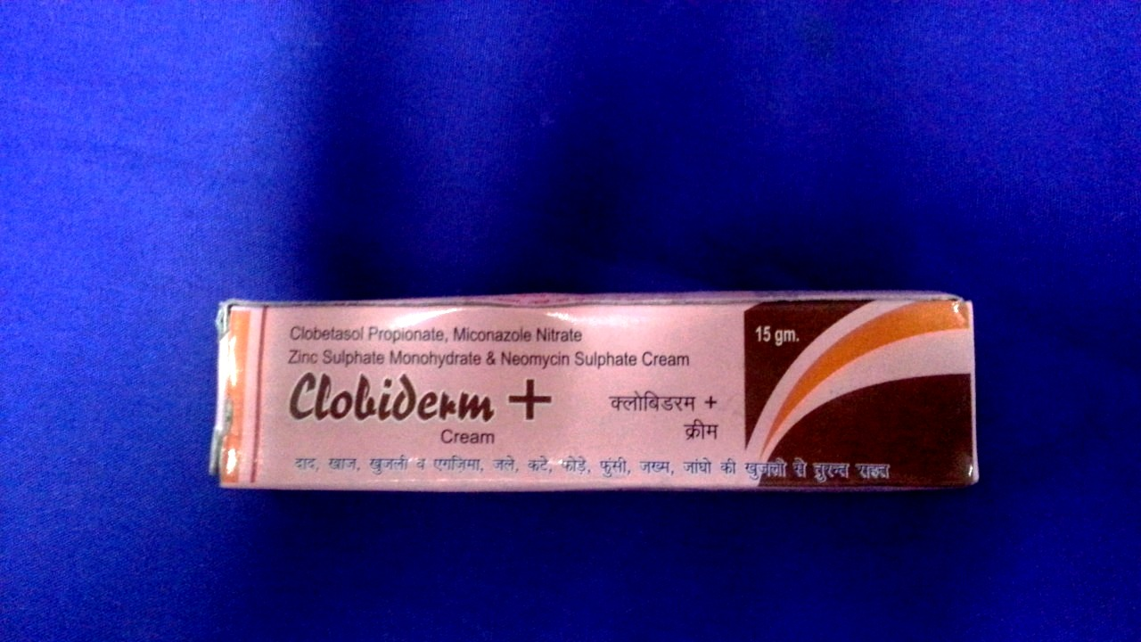
Tall claims by makers of irrational FDCs

Slide 71
Kindly do not get carried away by such claims

Slide 72
OATH
Henceforth I will use steroid cream Judiciously and only when indicated.

Slide 73
Take home message
Use steroid cream judiciously only for proper indication and in correct potency.
No steroid cream for any infection - bacterial or fungal ( ringworm )
Not to prescribe any steroid cream as fairness cream.
If any doubt about diagnosis kindly refer the patient to a dermatologist.

Slide 75
THANKS

